Slide 1
Applying the Global Compact for Safe, Orderly and Regular Migration in COVID-19 response and recovery efforts
IDM 2020
Panel 6
IOM and UNDP Joint presentation

Slide 3
Leveraging the GCM for COVID-19 Response and Recovery
Well governed migration can be a transformative way to:
mitigate negative impacts of COVID-19
help states to build stronger, more inclusive and resilient communities that protect human rights
stimulate strong socioeconomic recovery and accelerate implementation of the Sustainable Development Goals (SDGs).

Slide 4
Restoring the Positive Development Impact of Migration
Regular Migration, Decent Work and the Positive Development Impact of Human Mobility
Examples of Action:
Expediting procedures for the recognition of the professional qualifications of migrants and refugees (Argentina and Peru)
Outreach and direct support to migrant workers during the COVID-19 crisis through Migrant Worker Resources Centres (7 ASEAN countries)

Slide 5
No One is Safe Until Everyone is Safe
Social Inclusion and Migrant Integration
Examples of Action:
Access to the clinics dedicated to COVID-19 diagnosis, regardless of their migratory status or insurance (Canada)
Access to online education through the translation of online learning guidelines to support the registration of refugee and migrant children (Greece)

Slide 6
Connecting the GCM with the un socioeconomic response
Source:
UN Framework for the immediate socio-economic response to COVID-19

Slide 7
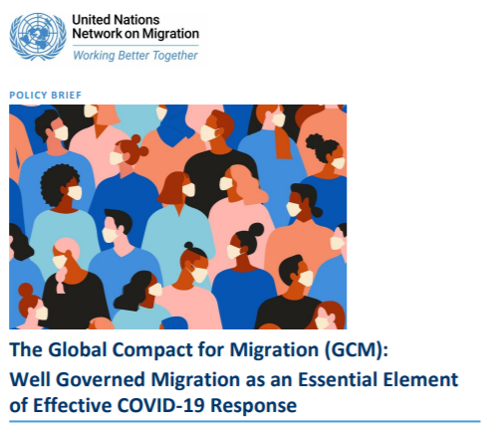
For more information, please consult the UN Migration Network Policy Brief under:
www.migrationnetwork.un.org

